Slide 1
Boston Blue Bike Data Analysis
Evaluating How Seasonality Affects Bike Usage
Anisha Kapoor, Julie Sarne, Arvind Kumar Murugesan Rajamallika, Didsayachai Prirungruang, Harsh Hegde
Section 5, Group 8

Slide 2



Business Question + Data Breakdown
How has seasonality historically affected bike usage trends? And within that:
How does weather affect general ridership trends?
Does seasonality affect the breakdown of usage between subscribers and one-off riders?
Did COVID equally affect ridership of subscribers and one-off users?
How did COVID vaccination affect Blue Bike ridership?
Data Sources:
Boston Blue Bike Data (Provided in Tableau): Provided from/to location, date/time of ride, and user profile from 2015-2021
Weather Data (Meteostat API): Provided Boston’s high/low temps, precipitation, and sunshine
COVID-19 Data Hub (the Johns Hopkins Centers for Civic Impact): Provided confirmed cases in Massachusetts (where Boston is located)

Slide 3
Conclusions + Recommendations
# of trips peaks in September; Blue Bikes needs to prepare for heaviest usage and repair needs in August and September.
In colder months, one-off riders represent 10% of Blue Bike rides, but in warmer months they represent 20% of rides. Marketing should capitalize on this shift.
Significant increase in share of one-off riders in 2021, especially as COVID cases fell. Blue Bikes should evaluate how many former subscribers may need persuasion to re-subscribe.
The rise of vaccines corresponded with the greatest # of rides taken in any month over three years (September 2021); Blue Bikes should evaluate whether additional docking stations are needed to meet new demand levels.

Slide 4
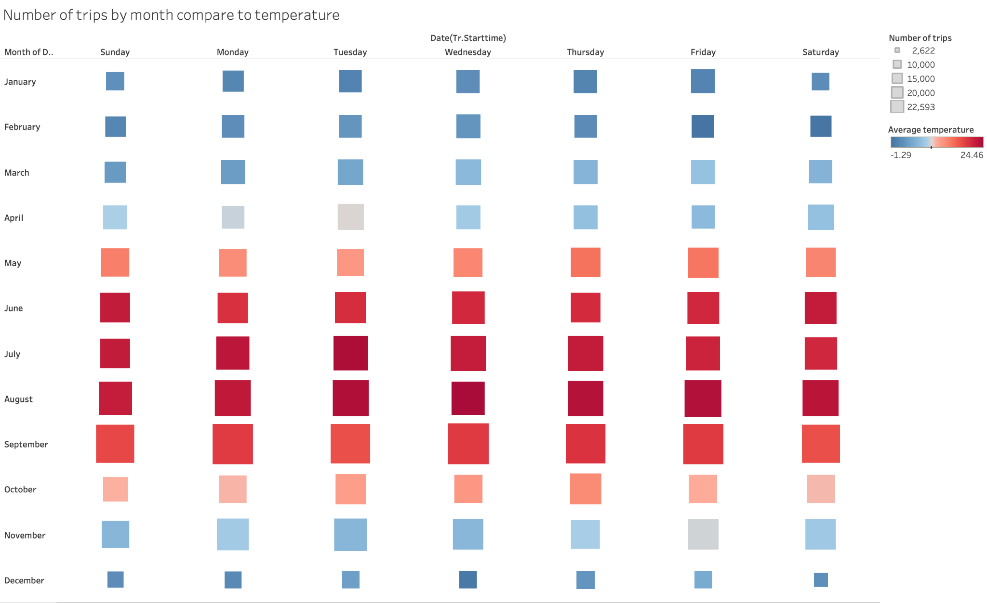
How does weather affect general ridership trends?
Our data showed that users tend to ride more in warmer months, as hypothesized.
We expected ridership to peak in May or June due to warming temperatures and summer months. However, the peak was in September, reflecting cooling temperatures after the hot summer and return to school.

Slide 5
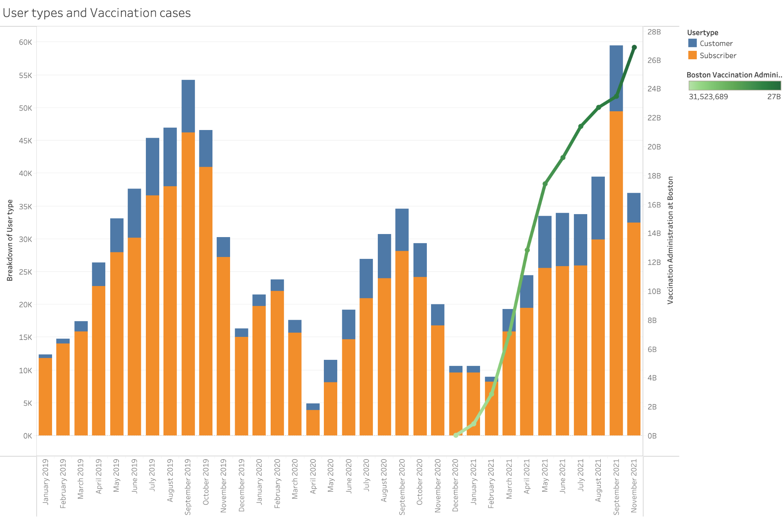
How did COVID vaccination affect Blue Bike ridership?
COVID vaccination rates rose as the weather became warmer - difficult to fully determine what factor drove the increase in rides
The rise of vaccination in 2021 corresponded with the greatest number of rides taken in three years throughout September 2021, especially driven by one-time riders

Slide 6
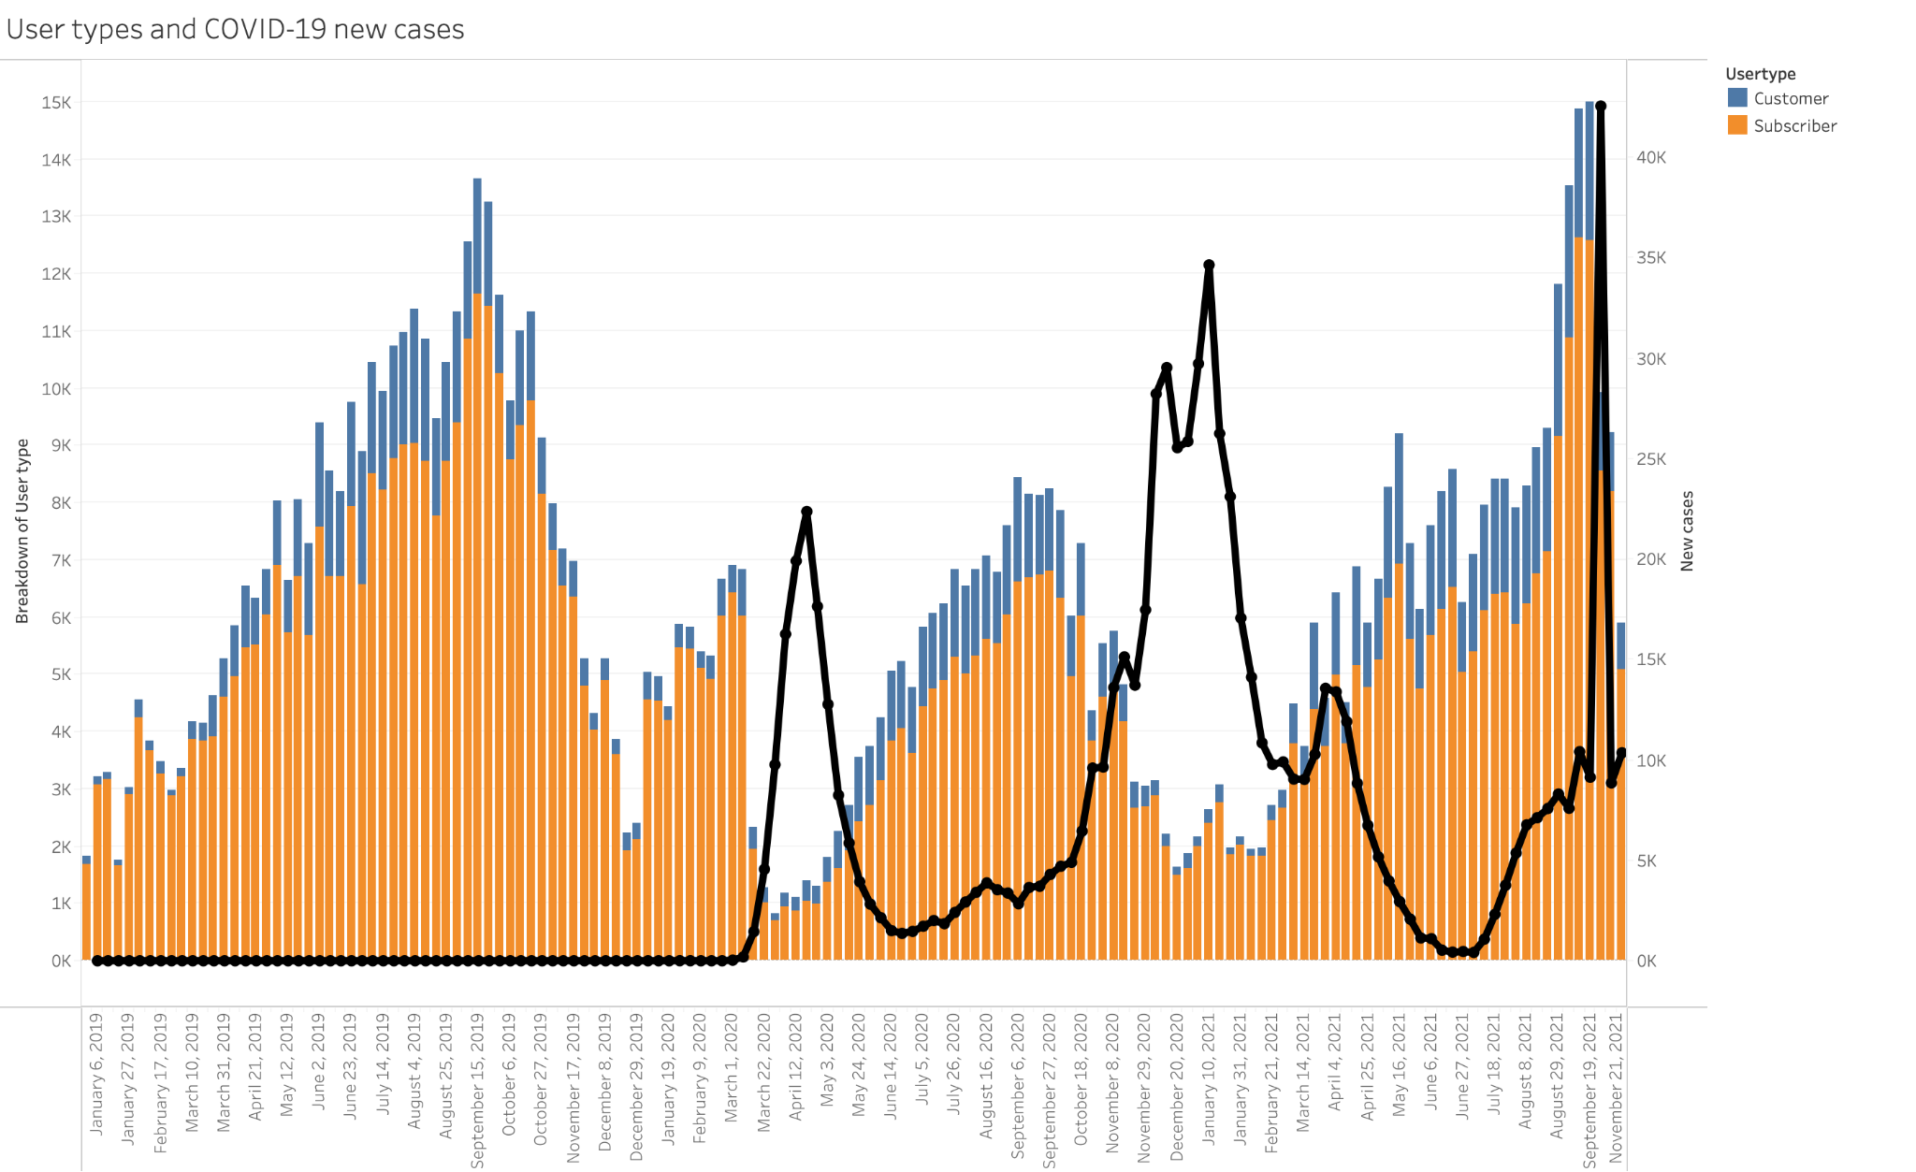
Appendix

Slide 7
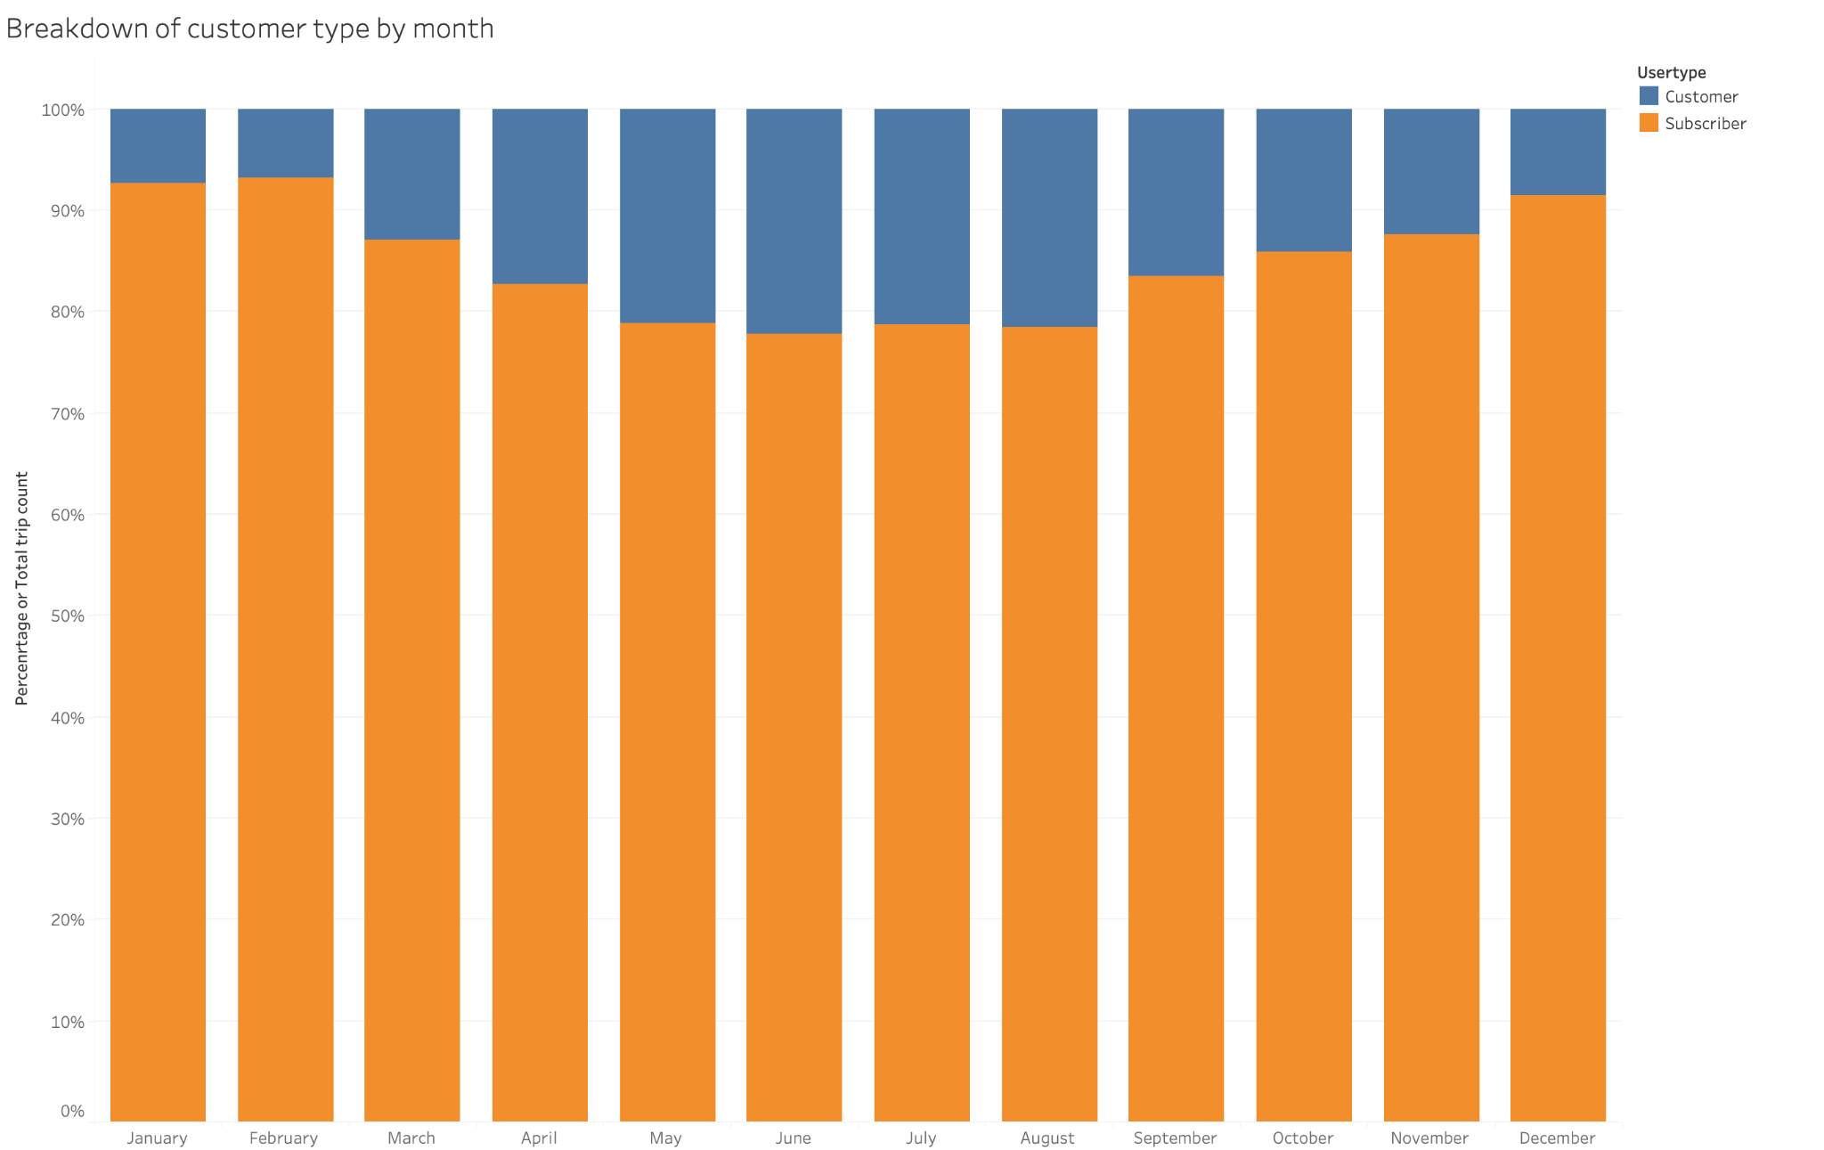

Slide 8
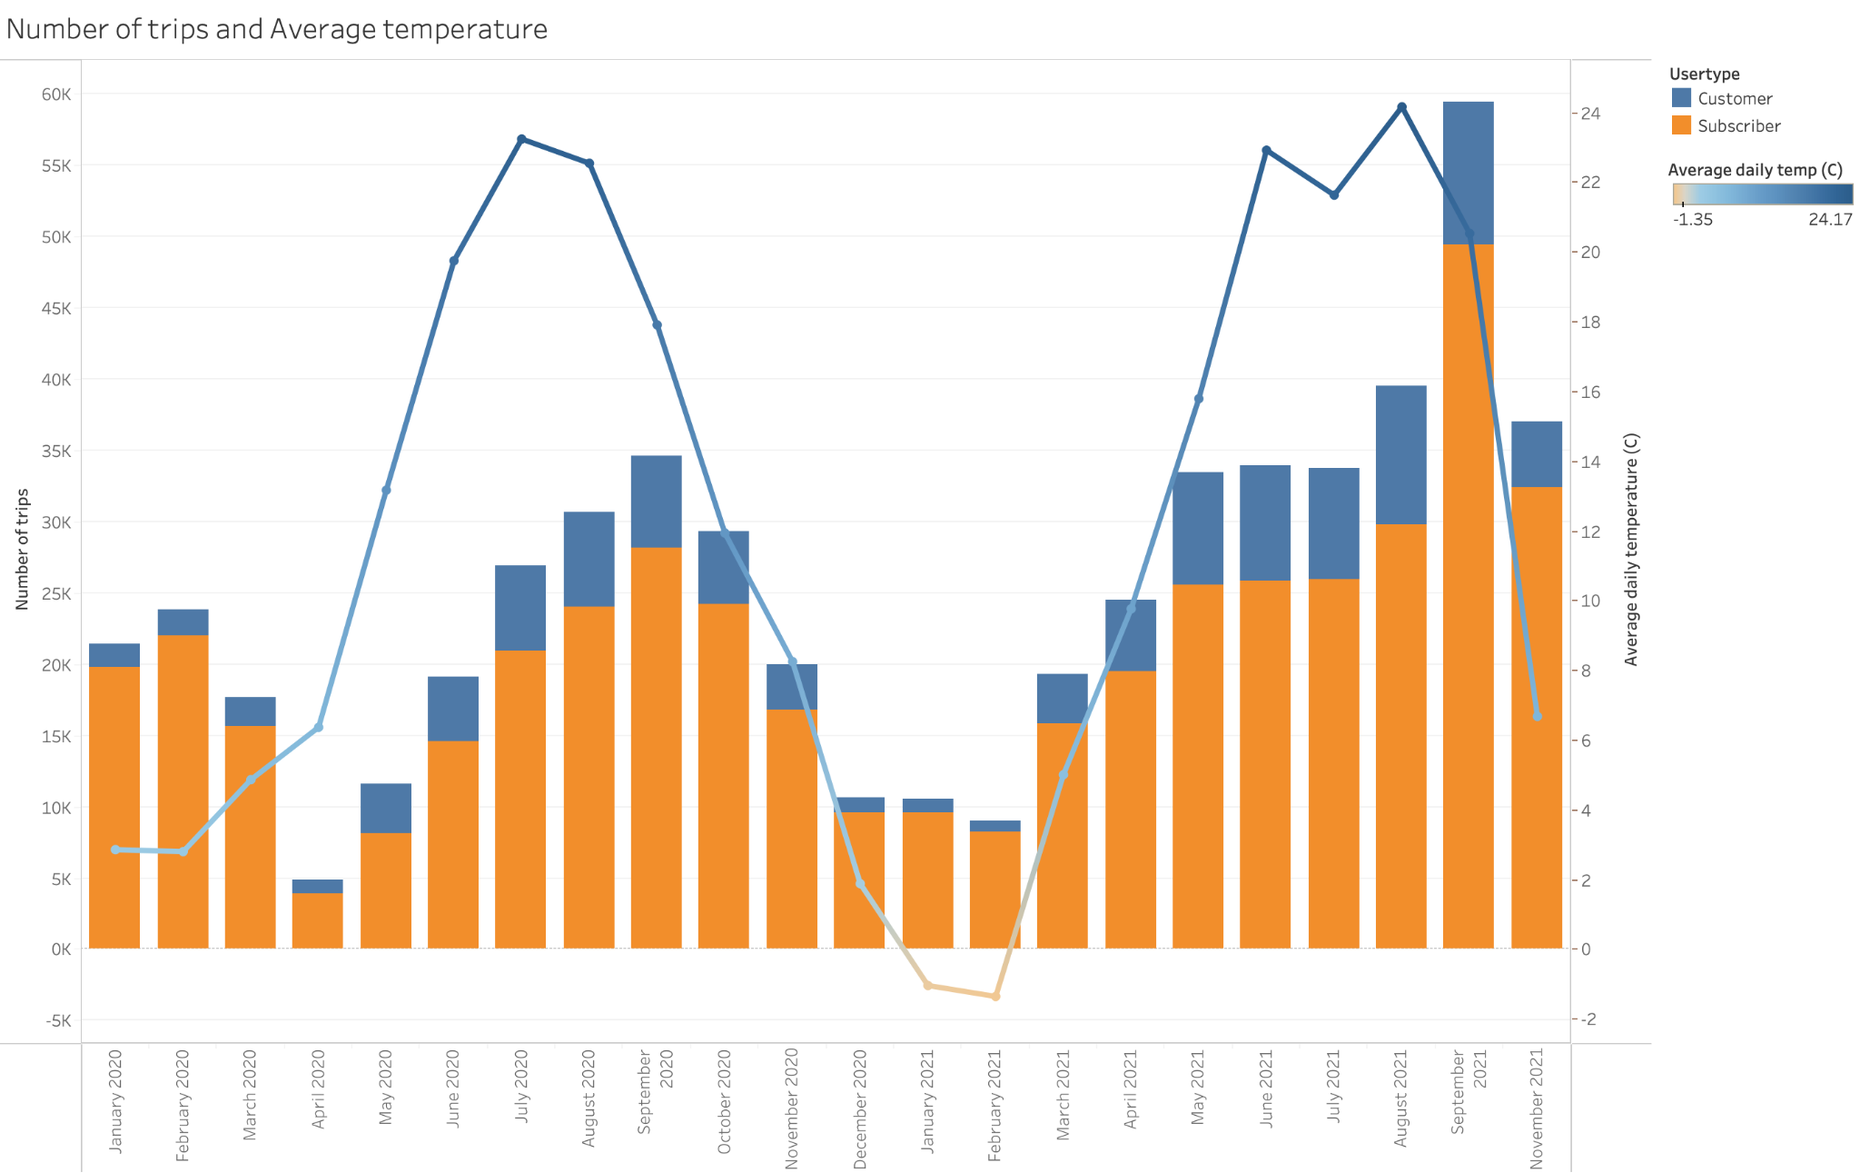
Do different age demographics have different usage patterns given weather?

Slide 9
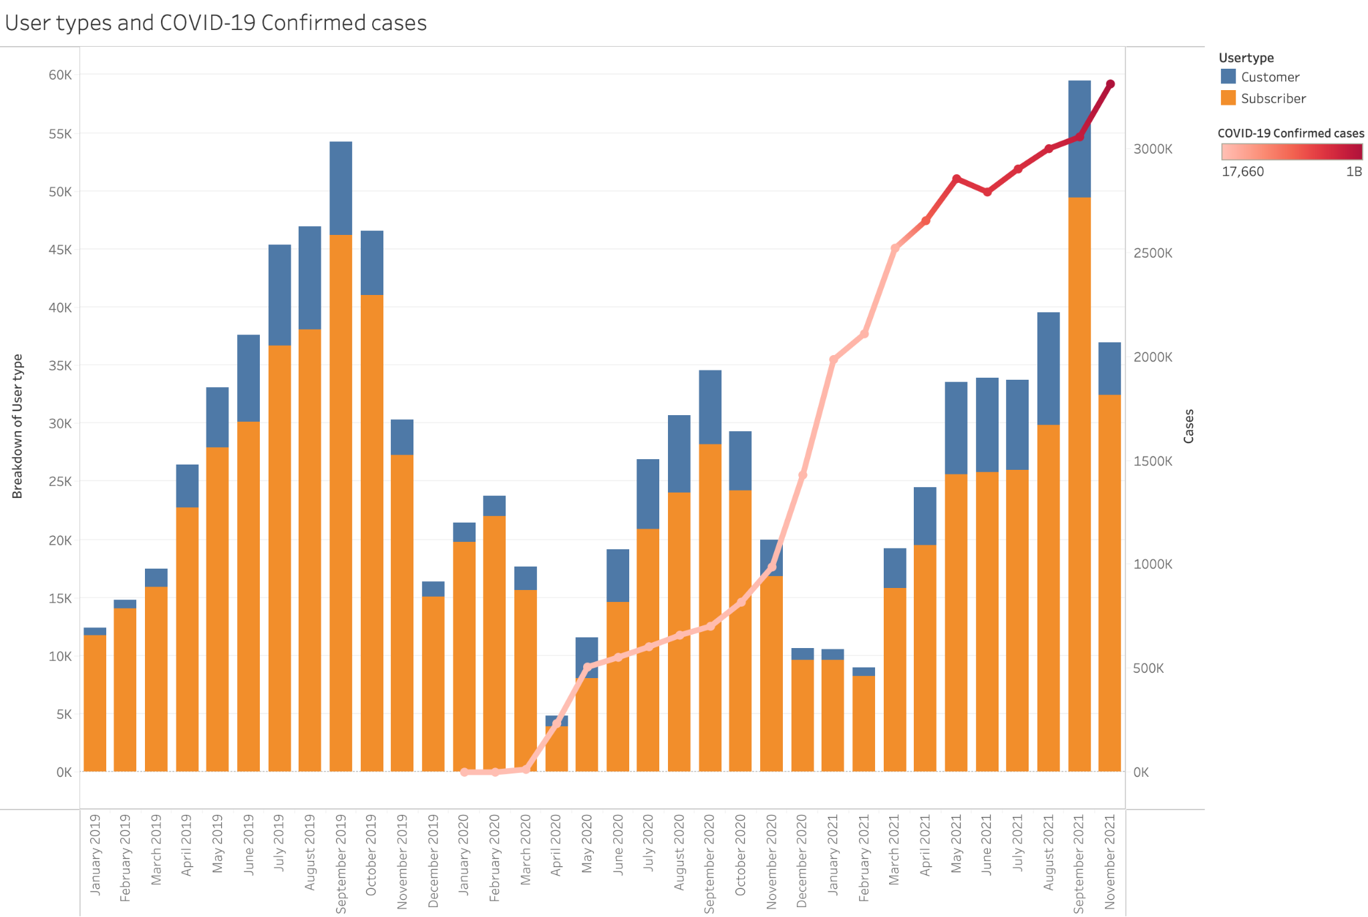

Slide 10
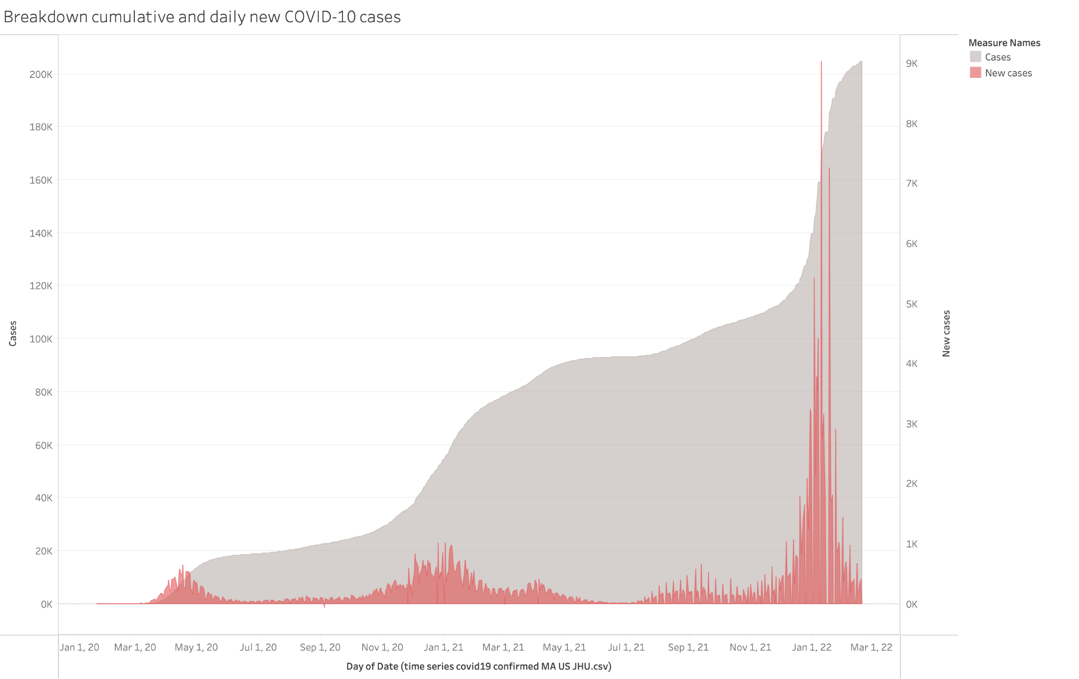

Slide 11
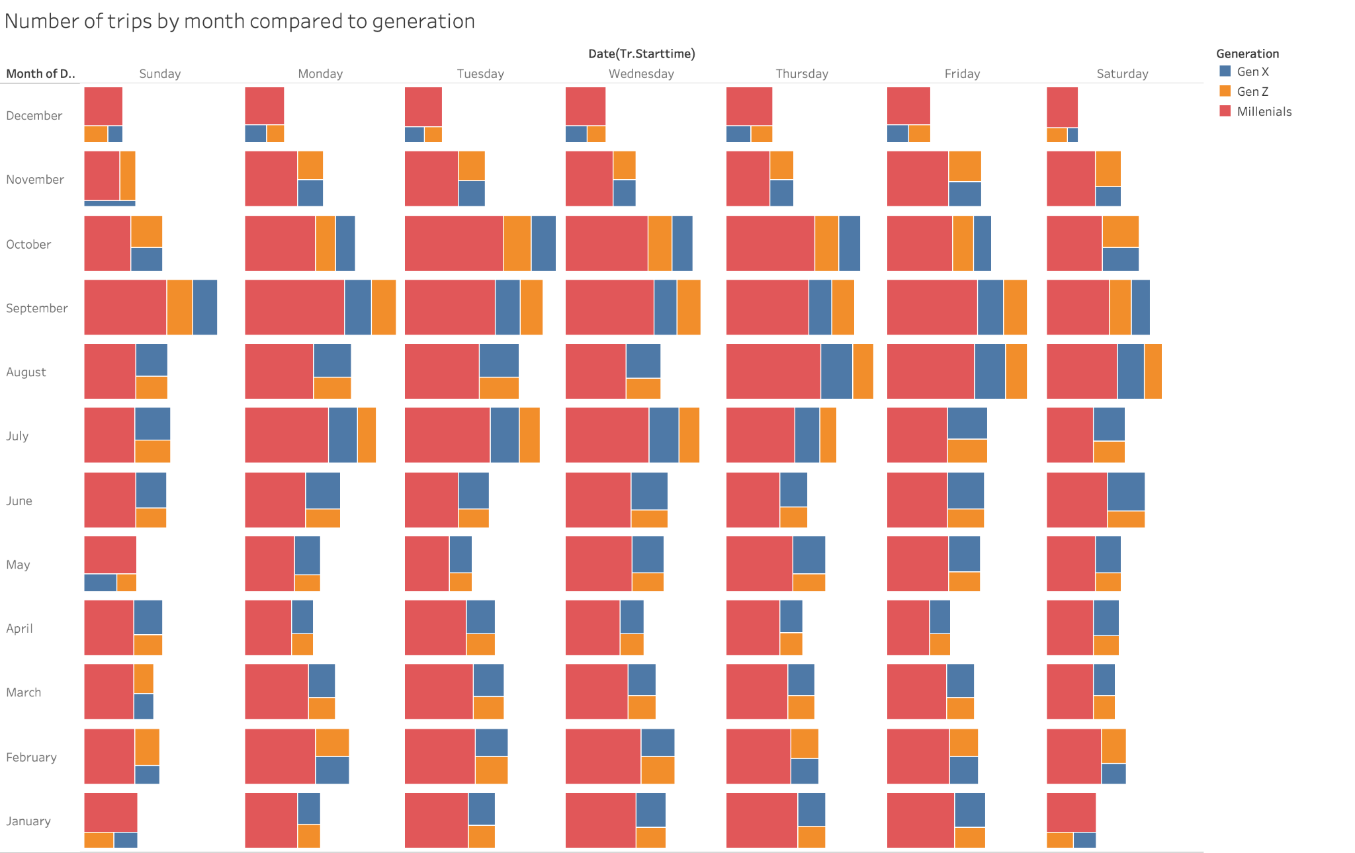

Slide 12
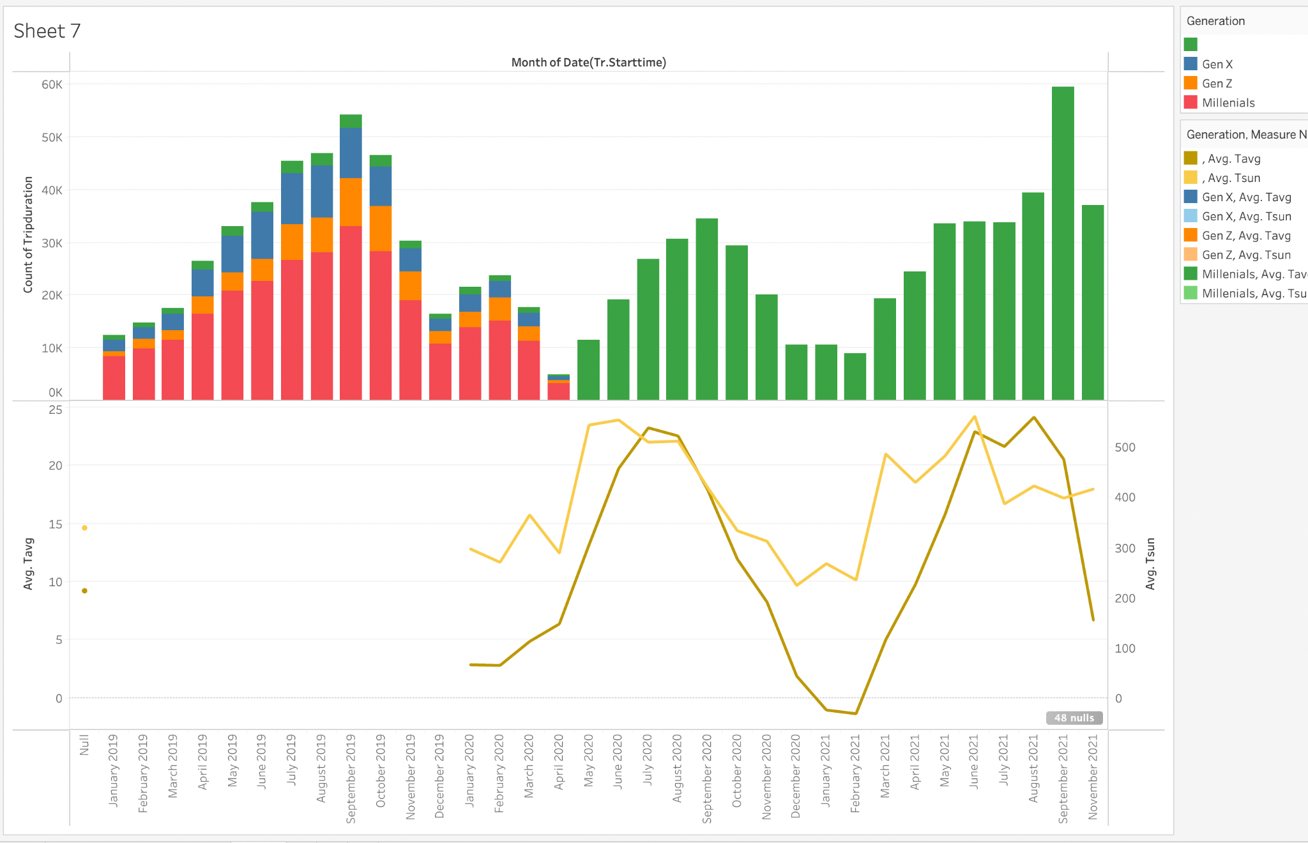
Do different age demographics have different usage patterns given weather?
For this question, I cannot find a relationship between data since we have generation only before 2019 but we have weather data after 2020.

Slide 13
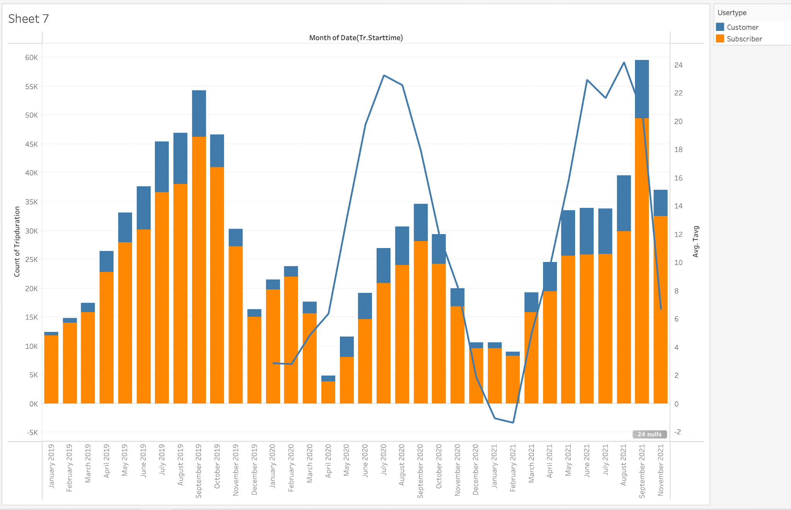
The only parameter that I can label for whole period is user type.

